Slide 1




Fake News! Detector
Brought to you by
Miguel, Paola, Alicia & Medha

Slide 2
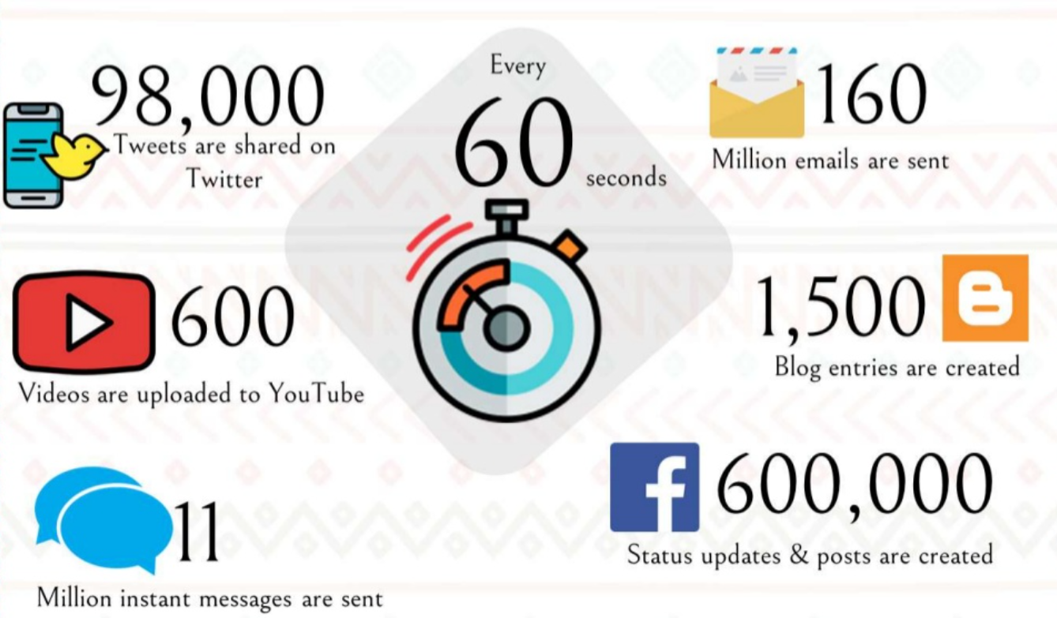
Why detecting fake news is so important?
Notes:
The spread of misinformation to this extent has severe negative impacts on our society. Therefore, it is imperative for us to be able to tell the difference between what’s true and what’s not.

Slide 3
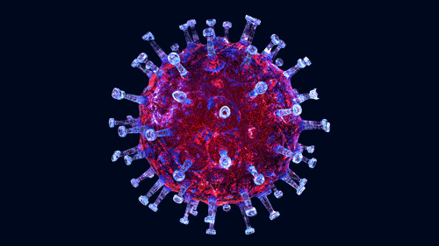
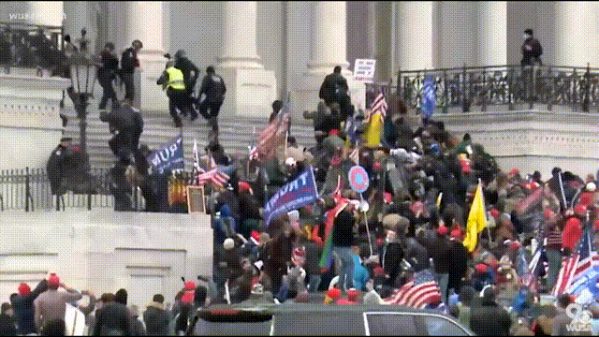
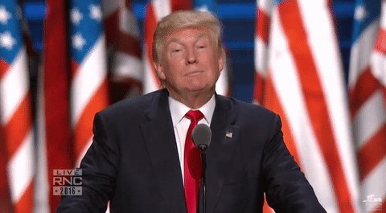
Why detecting fake news is so important?

Slide 4
Agenda
Data Collection
About ML Model
Explore Website
Visualizations and Analysis
Limitations
Questions?

Slide 5

Data
Testing data extracted from popular media Facebook pages like CNN, BBC, Fox News, and Buzzfeed
Facebook posts most resemble articles AND we can gauge activity (i.e Likes, Comments, Shares)
Dataset used to create, train and test the model was acquired from Kaggle

Slide 6
Machine Learning Model
92.74%
Prediction Accuracy
Used sklearn to split the data, create a TfidfVectorizer for our data, and a PassiveAggressiveClassifier

Slide 7
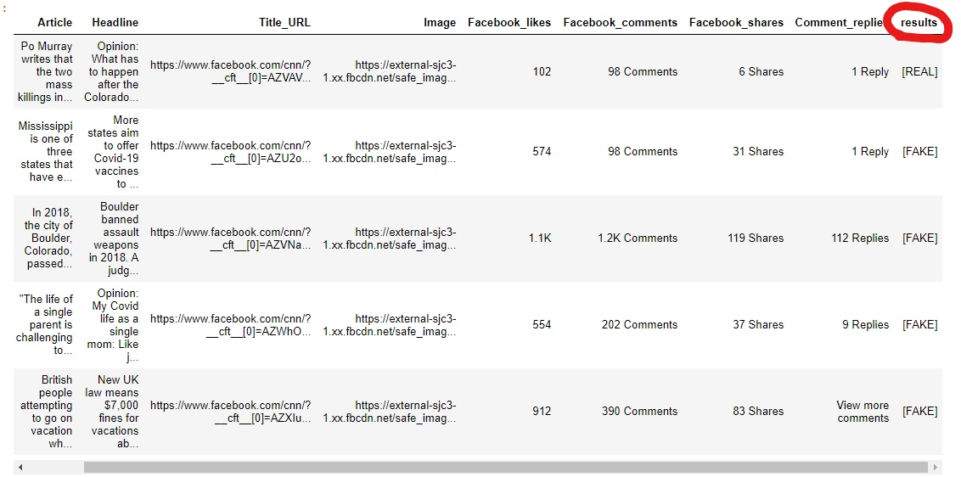
Using scraped articles from Facebook, model predicted if each article was “REAL” or “FAKE”

Slide 8

Let’s go on a trip!
FAKE NEWS! DETECTOR SITE
Notes:
All politics

Slide 9

Visualization & Analysis

Slide 10
Out of the 1,982 news articles we web scraped from Facebook, can you guess how many articles are tested Fake?

Slide 11
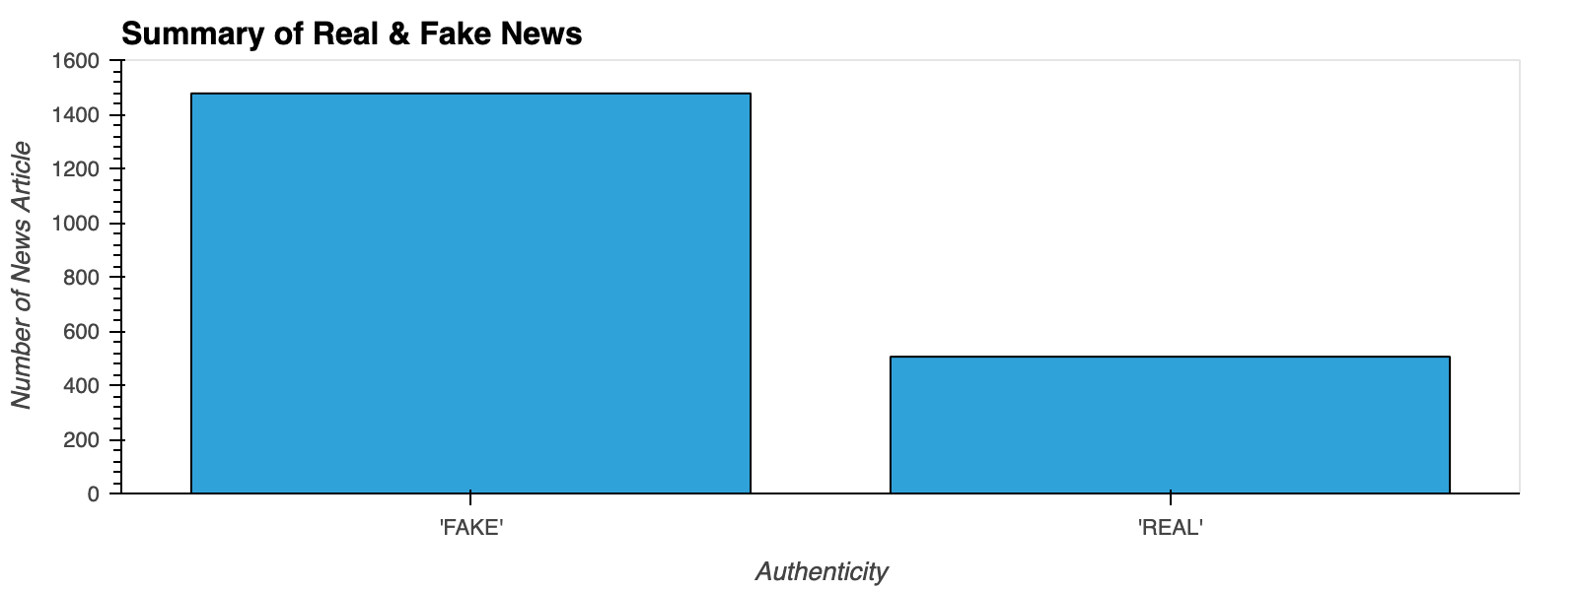
1477
505

Slide 12
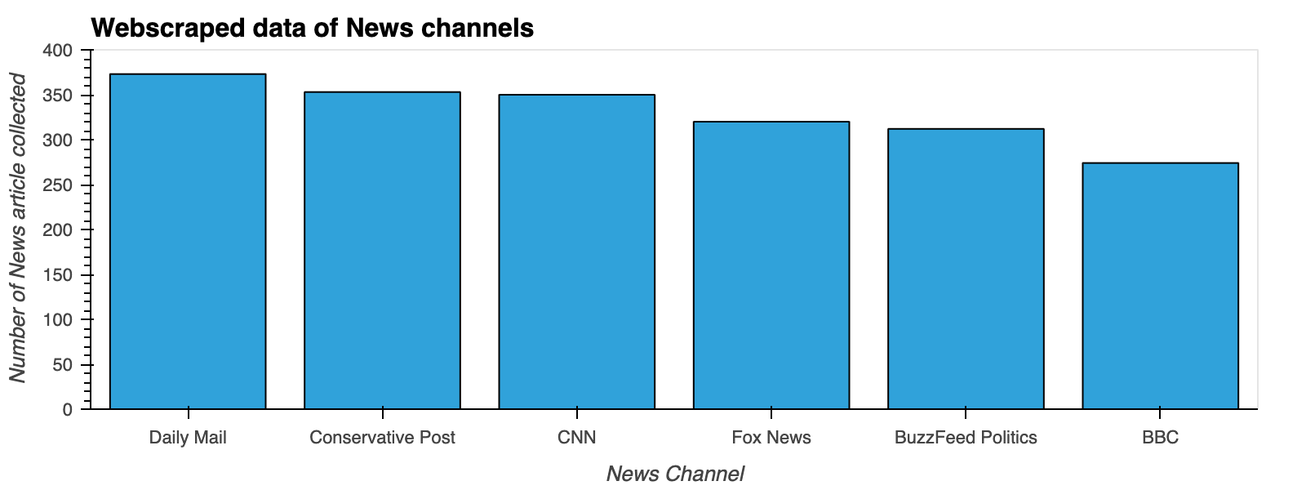
Summary of All News Channels

Slide 13
Facebook posts from: BBC, Buzzfeed Politics, Conservative Post, CNN, Daily Mail, Fox News
Take a guess, which news sources contribute the most “Fake" News?

Slide 14
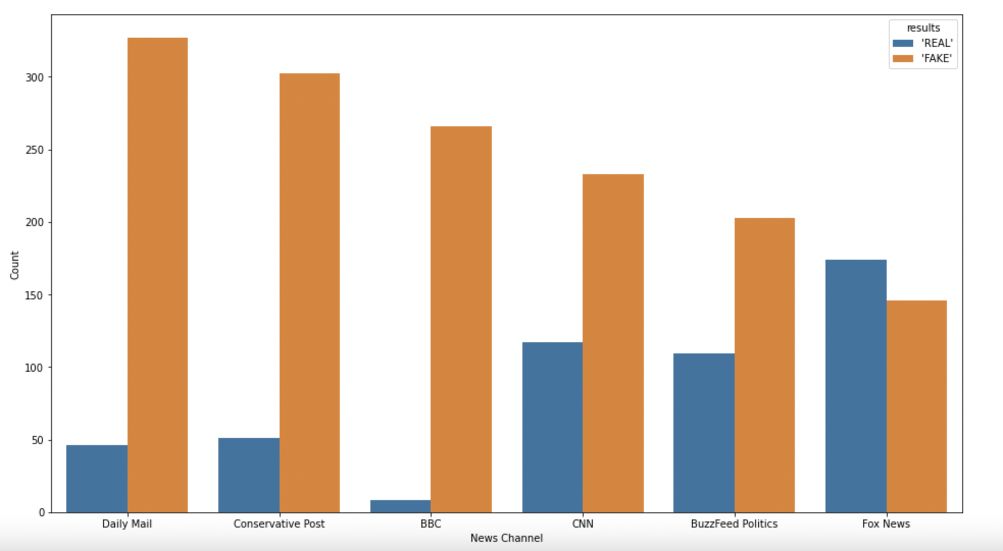
The winners: Daily Mail, Conservative Post, BBC
324
300
260
236
200
185
135
114
112
53
49
14

Slide 15
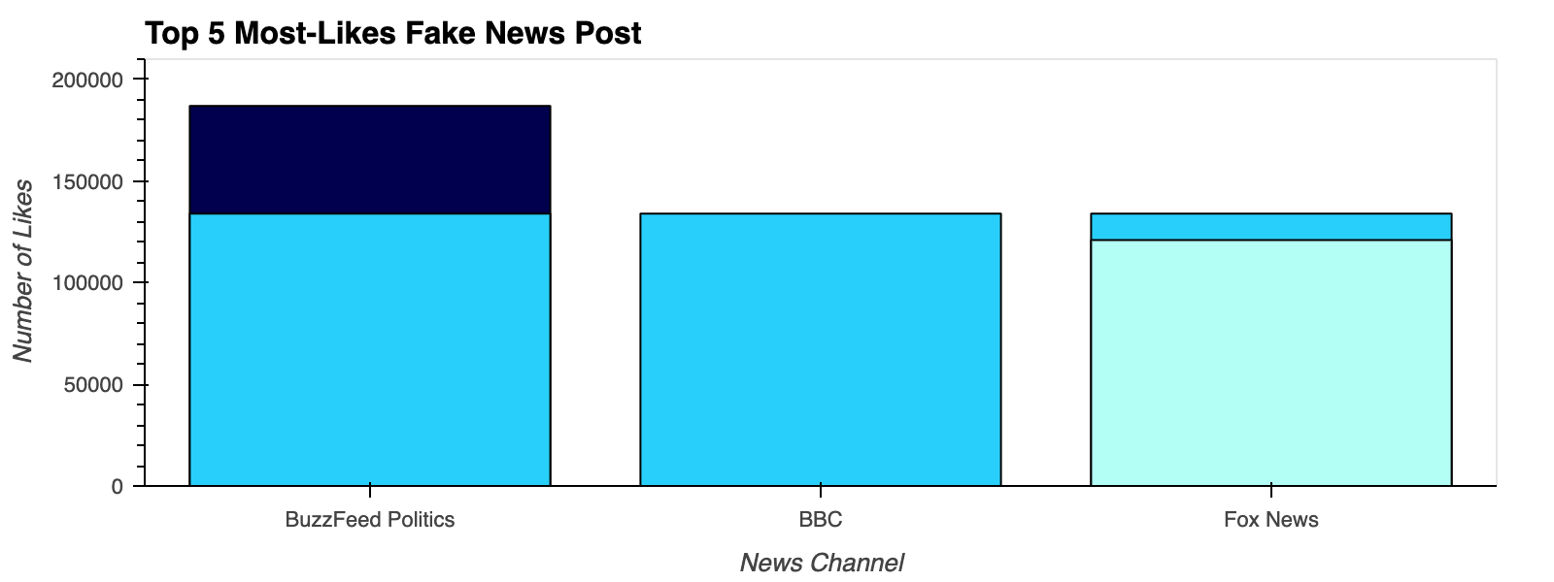
187k
134k
134k
134k
121k

Slide 16
Most-Liked Article Titles
“What Jurors In Derek Chauvin’s Trial Think About Black Lives Matter, Defund The Police, Racial Justice Protests” - BuzzFeed Politics - 187k Likes - 32k Comments - 23k Shares
“A beautiful tribute from Call the Midwife to mothers and their children, and to babies lost but never forgotten” - BBC - 134k Likes - 59k Comments - 20k Shares
“Prosecutors Say The Oath Keepers’ Leader Directed Followers During Capitol Riot” - 134k Likes - 3.1k Comments" - BuzzFeed Politics - 134k Likes - 59k Comments - 20k Shares
“White House says Biden is 'quite busy' after Putin invites president for 'live' chat” - Fox News - 134k Likes - 59k Comments - 20k Shares
“Trump returning to social media with 'his own platform' in 2-3 months: adviser” - Fox News - 121k Likes - 16k Comments - 9k Shares
Notes:
⅗ - political
⅖ people’s news/views

Slide 17
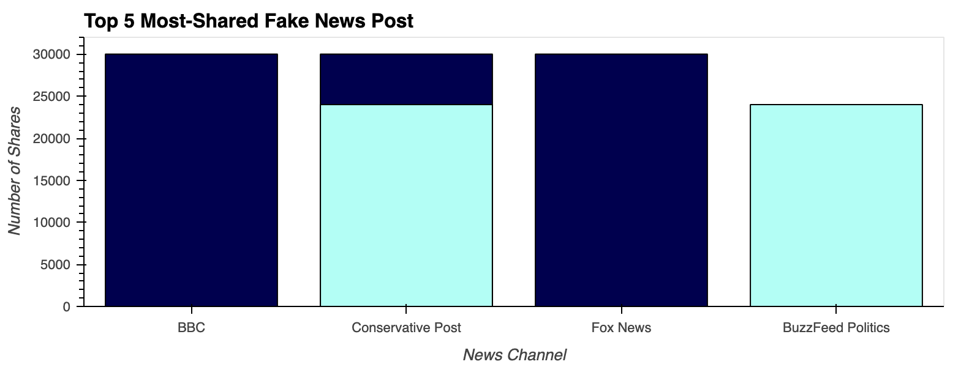
30k
30k
30k
24k
24k

Slide 18
Most-Shared Article Titles
“Vertical farms are popping up all over the world.” - BBC - 30k Shares - 1.1k Likes -37 Comments
“Tucker Carlson: From Andrew Cuomo To The Lincoln Project, Media Protected The Worst Of Politics” - Conservative Post - 30k Shares - 204 Likes - 37 Comments
“Biden administration awards ICE $86M contract to secure hotel rooms for illegal families" - Fox News - 30k Shares - 91k Likes - 41k Comments
“This Woman Also Got A Hilariously Unfortunate Tattoo Because This Era Is Truly Batshit” - BuzzFeed Politics - 24k Shares - 134k Likes - 9k Comments
“Tim Allen Rips American Tax System, Says He ‘Liked’ That Trump ‘P***ed People Off’” - Conservative Post - 24k Shares - 203 Likes - 9k Comments
Notes:
⅔ political
The rest is more of personal views

Slide 19
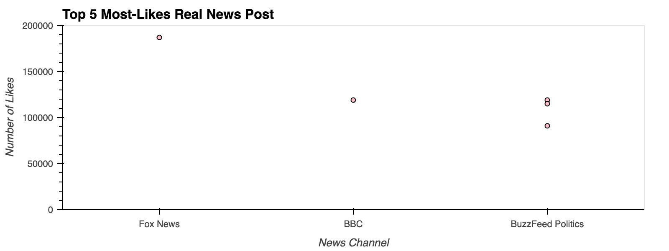
187k
119k
119k
115k
91k

Slide 20
Most-Liked Article Titles
“Former President Donald Trump released a statement Sunday slamming the Biden administration's handling of the southern border.” - Fox News - 187k Likes - 32k Comments - 23k Shares
“The moment when Sir David Attenborough got upstaged by a bird” ” - BBC Video - 119k Likes - 23k Comments - 16k Shares
“Mark Changed The Rules”: How Facebook Went Easy On Alex Jones And Other Right-Wing Figures" - BuzzFeed Politics - 119k Likes - 23k Comments - 16k Shares
“Asylum-Seekers Trump Forced To Wait In Mexico Are Now Arriving In The US: “When The Bus Took Off, We All Cheered” - BuzzFeed Politics- 115k Likes - 32k Comments - 17k Shares
“The Capitol Police Released Its Annual Public Report. It’s One Page Long” - BuzzFeed Politics - 91k Likes - 41k Comments - 30k Shares
Notes:
Sparse out in topics

Slide 21
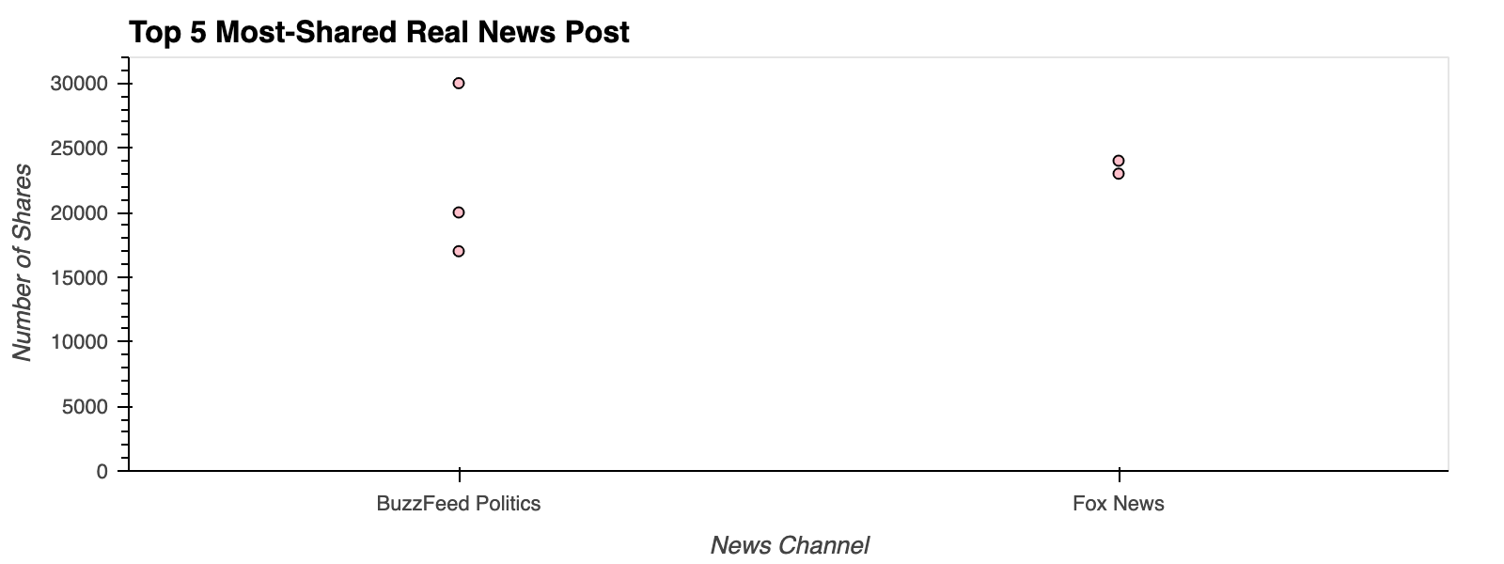
30k
24k
20k
23k
17k

Slide 22
Most-Shared Article titles
“The Capitol Police Released Its Annual” - BuzzFeed Politics - 30k Shares - 91k Likes - 41k Comments
“Rep. Burgess Owens tweeted out his criticism of the Biden administration on Friday amid the surge of migrants at the U.S.-Mexico border.” - Fox News- 24k Shares - 91k Likes - 9k Comments
“Former President Donald Trump released a statement Sunday slamming the Biden administration's handling of the southern border." - Fox News - 23k Shares - 187k Likes - 32k Comments
“In his first White House press conference, Biden suggested he could support drastic change to how the Senate works.” - BuzzFeed Politics - 20k Shares - 36k Likes - 17k Comments
“Asylum-Seekers Trump Forced To Wait In Mexico Are Now Arriving In The US: “When The Bus Took Off, We All Cheered” - BuzzFeed Politics - 17k Shares - 115k Likes - 32k Comments
Notes:
All politics

Slide 23
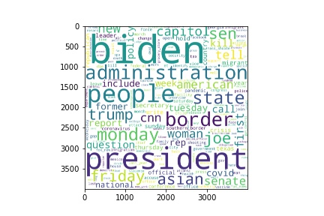
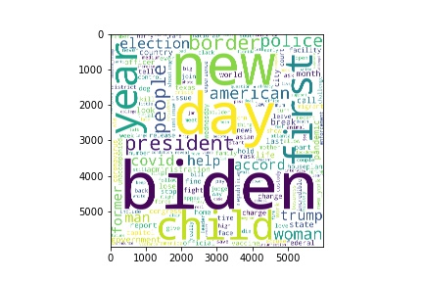
A word cloud of most commonly used words in fake and real news:
Word cloud of true news
Word cloud of fake news
Notes:
The words with the biggest font size here depict that those are the most commonly appearing words and as we can see with the occurrence of the words, ‘Biden’, ‘president’ and ‘trump’ so frequently, I think it is safe to say that we consume a lot of misinformation about politics and the presidency. Moreover, if you look a little more closely, “Covid” is more prominent in the words that appear in fake news. It is appalling to learn that there is more fake news than real about a disease that has and continues to lead to so much death and distress worldwide.

Slide 24
t-SNE PLOTS
t-SNE stands for t-Distributed Stochastic Neighbor Embedding
t-SNE plots are used to group words into clusters
Converts multi-dimensional data points into two-dimensional data points
Reveals patterns in the data that we may not be aware of
Used t-SNE distributions for grouping words so we could extract data about words most commonly accompanying certain primary words

Slide 25
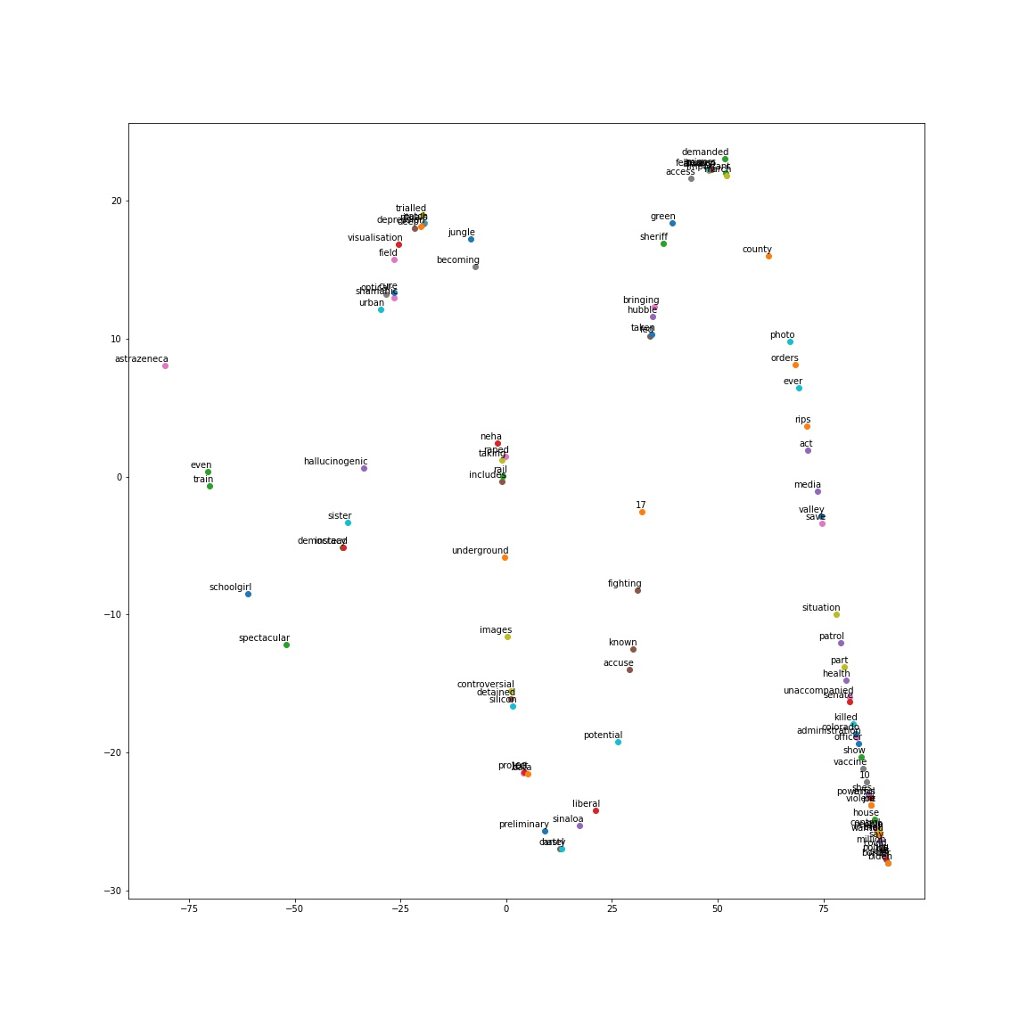
t-SNE
t-SNE for real news

Slide 26
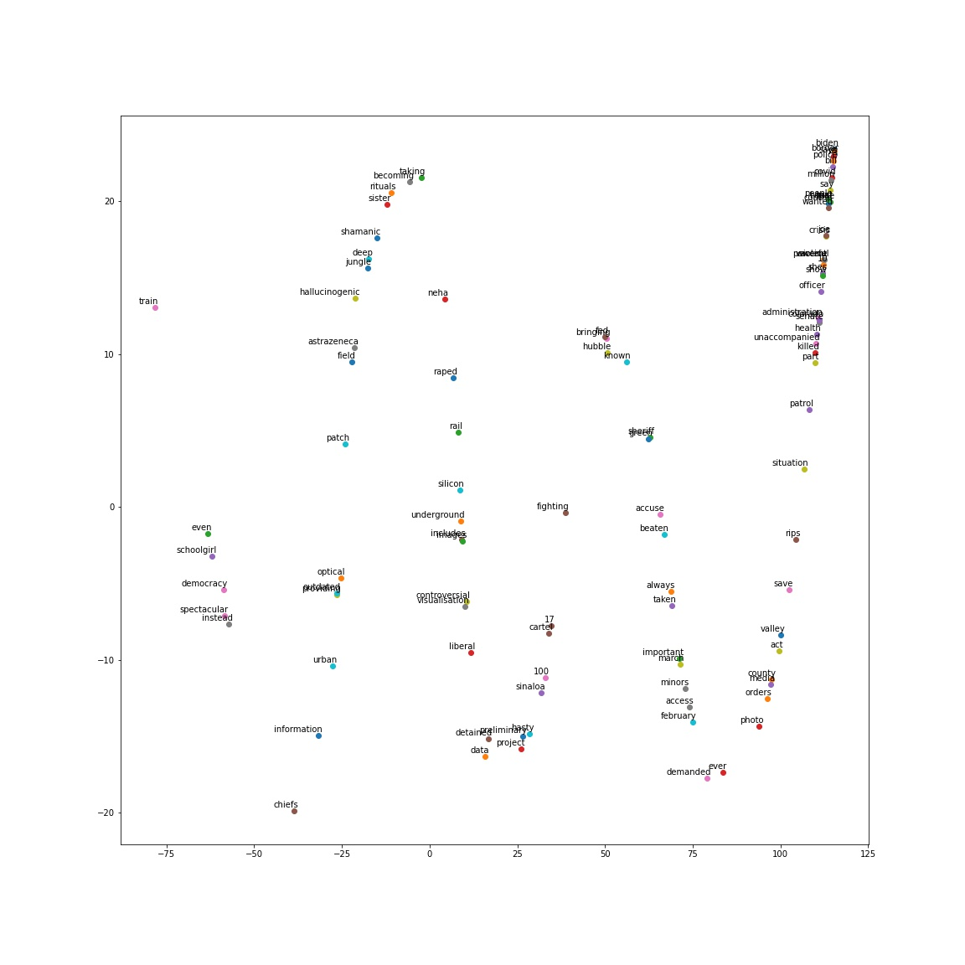
t-SNE
t-SNE for fake news

Slide 27
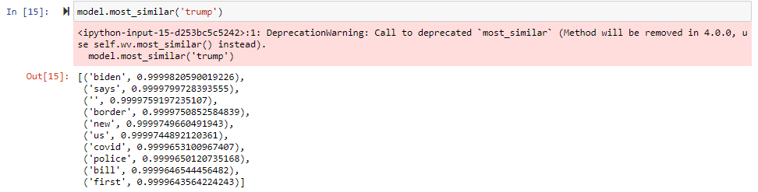
Words Accompanying Other Words
Probability of the word that appears along with “Trump”
Words that appear most commonly with the word “Trump”

Slide 28
Limitations/Problems We Faced
Data Collection
Needed multiple sources, social media engagement, and access to headlines and articles
Sometimes there were comments meant for posts, not for news articles that got fed into the machine
Video, live, etc.
Tricky to render a working “Detector” on the website
Took some time discussing which visualizations to present
Dream scenario is being able to scrape all the data from those news source pages over the years to see longitudinal trends

Slide 29

Questions?

